Slide 1
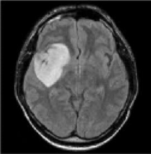
GENERATING HIGH-FIDELITY BRAIN TUMOR IMAGES WITH DEEP CONVOLUTIONAL GANS
ROSHAN NAIDU(21BAI1300)
OM SUBRATO DEY (21BAI1876)
SAURAV MISHRA (21BAI1299)
LEKI CHOM THUNGON

Slide 2
INTRODUCTION
Availability of medical data and the development of artificial intelligence have stimulated computer vision and its application in health care. One of the most significant healthcare problems is the proper identification, categorization, and division of brain tumors from medical imaging such as MRI scans. The task of annotating these images with the help of radiologists is a very tedious process and is associated with inter-observer variability. Thus, the methods of the tumor identification, segmentation, and analysis that are automated and can be easily scaled are critical. DCGANs have found great importance as a generative model in producing high diverse and realistic images with good quality, which are beneficial in enhancing datasets and, by extension, the performance of machine learning models.
The need for richer and high-fidelity synthetic data in medical imaging applications has arisen because of the problems that come with data acquisition and annotation of large datasets of real medical images. In particular, brain tumor images have the problem of limited datasets available for public use because of privacy and obtaining high-quality annotations. The challenges outlined above shall be solved with this study’s intention of using DCGANs to generate synthetic brain tumor images. Thus, the first approach is aimed at enhancing the quality of the image and the variety of the generated samples for the purpose of expanding training sets for a variety of MIP tasks.

Slide 3
ARCHITECTURE OF THE MODEL
1. THE NOISE INPUT (DATASET SOURCE FROM KAGGLE)
2. THE GENERATOR PART OF THE MODEL.
3. THE DISCRIMINATOR PART OF THE MODEL.
4. THE COMPLETE MODEL COMBINATION INCLUDING THE GENERATOR AND THE DISCRIMINATOR.

Slide 4
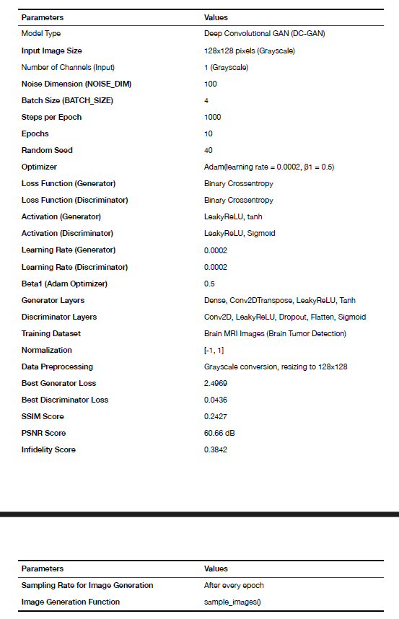
COMPLETE DC-GAN MODEL SETUP FOR THE RESPECTIVE TASK

Slide 5
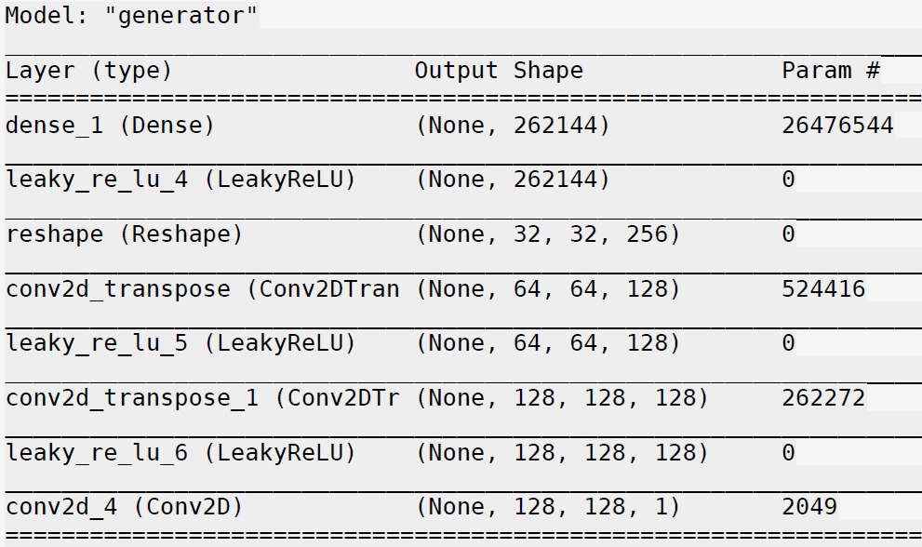
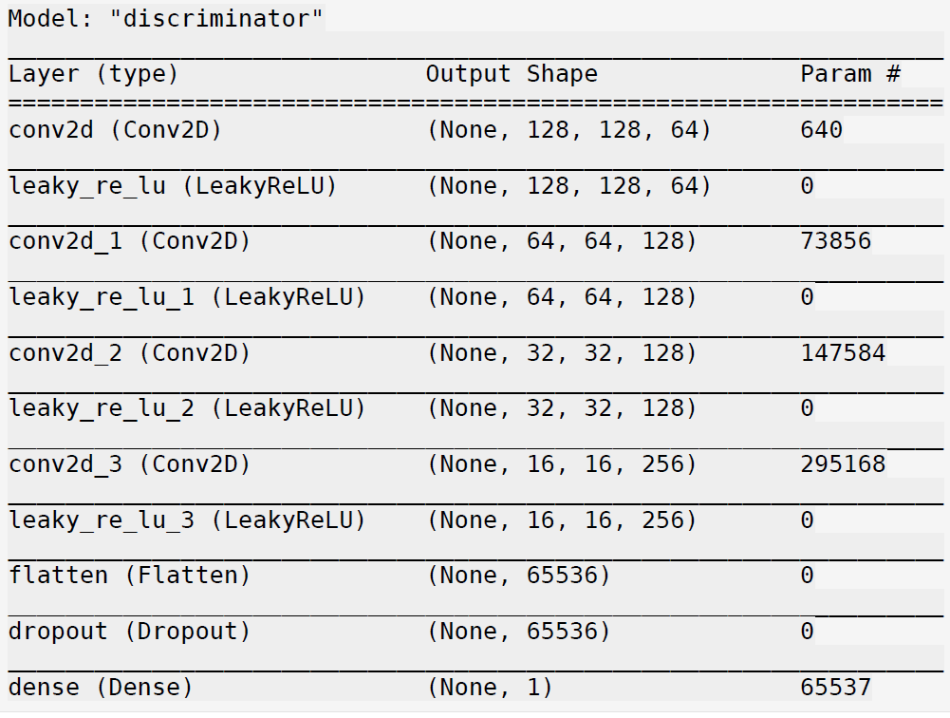
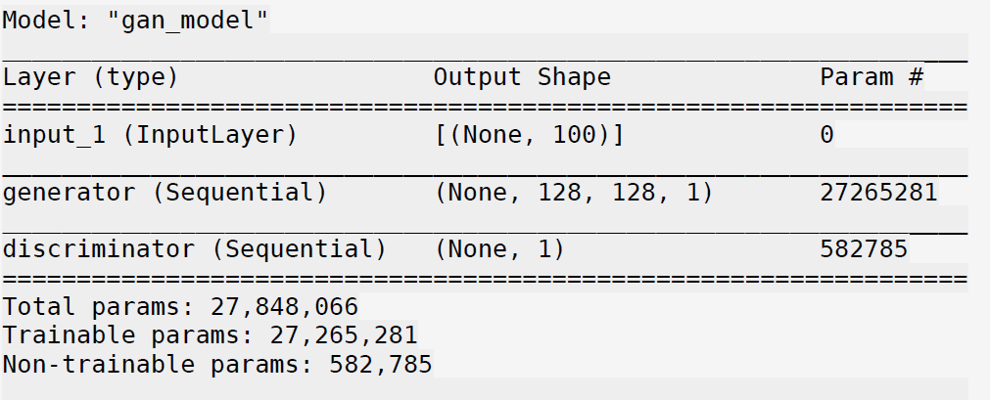
THE COMPLETE DC-GAN ARCHITECTURE USED IN THE WORK.

Slide 6
METHODOLOGY
MRI brain images were sourced from Kaggle's Brain Tumor Detection dataset. Images were preprocessed by converting to grayscale and resizing to 128x128 pixels. The load_images() function handled preprocessing, normalization to [-1,1], and loading images as NumPy arrays. For training, 20 images were randomly selected, resized to match model input dimensions.
Model Architecture:
Generator: Transformed a 100-dimensional latent noise into 128x128 grayscale images using Dense, LeakyReLU, and Conv2DTranspose layers. Binary cross-entropy loss and the Adam optimizer (β=0.5) were employed.
Discriminator: Classified real vs. fake images using Conv2D layers, LeakyReLU activations, Flatten, and Dropout layers, outputting binary classification via a sigmoid neuron. It also used binary cross-entropy loss and Adam optimization.
GAN: Combined the generator and discriminator, with the discriminator made non-trainable during GAN training.
Training Process: The GAN trained for 10 epochs with 1000 steps per epoch. Each step involved generating fake images from Gaussian noise and using real images from the dataset. The generator aimed to deceive the discriminator, which classified images as real or fake. Training loss for both components was recorded, and generated images were visualized after each epoch.
Evaluation: The model was assessed using Structural Similarity Index (SSIM) and Peak Signal-to-Noise Ratio (PSNR). SSIM averaged over batches, and higher PSNR indicated better quality. Hyperparameters like noise dimension (100), batch size (4), and steps per epoch (1000) were optimized, resulting in a generator loss of 2.4969.
Visualization: Training progression for generator and discriminator losses was plotted. Seaborn distplots analyzed variations between real and generated images.

Slide 7
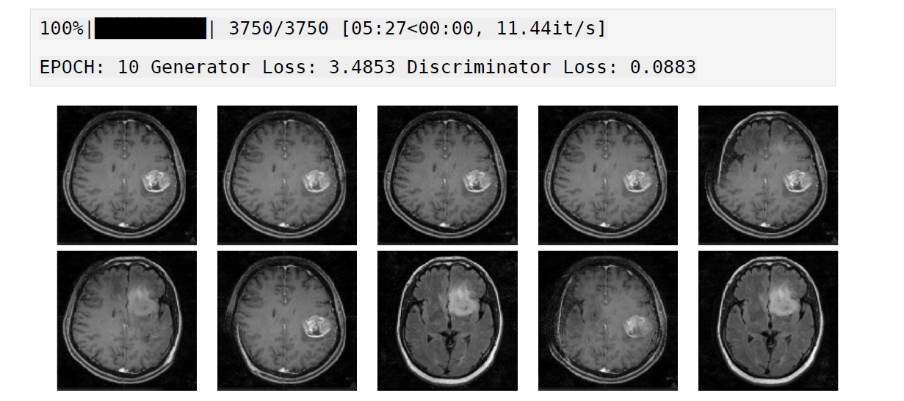
TRAINING PROCESS
The training process for GAN involved training for 10 epochs, but each epoch was made of 1000 iterations or steps. In each step, random noise vectors of Gaussian distribution were utilized to create fake images which were used along with real images from the training dataset. Discriminator learned batches of real and fake images while generator learned how to generate images that latter classifies as real by discriminator. during training the loss values of both the generator and discriminator functions were recorded for analysis. Image generation was also performed after every epochs within the training loop of the Convolutional Neural Network. The sample_images() function was used to generate and show a grid of generated images to let a user track the training progress.

Slide 8
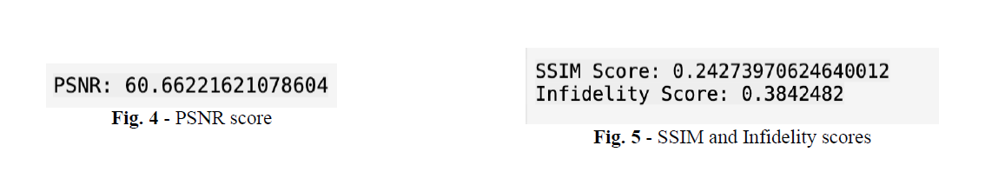
EVALUATION METRICS
To quantitatively evaluate the quality of the generated images, the following metrics were computed:
Structural Similarity Index (SSIM): SSIM is a perceptual metric that assesses the similarity between real and generated images. The final SSIM score for the generated images was 0.2427, indicating moderate structural similarity.
Peak Signal-to-Noise Ratio (PSNR): PSNR measures the quality of the generated images compared to the original images. The PSNR score was found to be 60.66 dB, which is high, reflecting the close resemblance of the generated images to real images.
Infidelity Score: An infidelity score of 0.3842 was computed, reflecting the model's capacity to generate images with a balance between fidelity to the real data and variability.

Slide 9
RESULTS AND ANALYSIS
Training Overview:
Over 10 epochs, the generator loss decreased from 6.6827 to 3.4853, indicating improved performance in generating realistic images.
The discriminator loss slightly increased from 0.0436 to 0.0883, suggesting that the discriminator maintained its effectiveness as the generator improved.
Optimal Configuration:
Noise dimensions: 100
Batch size: 4
Steps per epoch: 1000
This configuration achieved a generator loss of 2.4969 by epoch 10.
Visual Quality:
Visual inspections showed improved fidelity and realism in the generated images over epochs.
Distribution plots revealed high overlap between real and generated images, confirming the model’s ability to produce realistic outputs by epoch 10.
Loss Trends:
A balanced training process is indicated by the decreasing generator loss and the slightly increasing discriminator loss.
Conclusion:
The optimal configuration and training approach were effective in producing realistic brain tumor images.
The results highlight improvements in image quality, fidelity, and the model’s ability to generate realistic data.
This analysis emphasizes that the DC-GAN achieved balance and improved performance, validating the chosen hyperparameters and training strategy.

Slide 10
RESULTS AND ANALYSIS
As observed from the training loss curves, the generator loss gradually decreased over the training epochs, while the discriminator loss showed a slight rise, indicating that the GAN had achieved a balance in its adversarial learning process. The final loss values suggest that the generator became increasingly proficient at generating images that were difficult for the discriminator to distinguish from real images which can be seen in below figure.

Slide 11
RESULTS AND ANALYSIS
Simulations of the GAN were conducted after every epoch, and the generated images were displayed for visual inspection. The improvement in image fidelity over epochs is evident in the simulation outputs, with earlier epochs showing noisier, lower-quality images, and later epochs producing clearer, more accurate brain tumor images as in figure alongside demonstrating for real and generated images.

Slide 12
CHALLENGES AND LIMITATIONS
1. Data Challenges 4. Domain – Specific Concerns
-> Limited Data Availability -> Clininical Relevance
-> Imbalanced Datasets -> Interpretability and Validation
-> High Variability
2. Image Quality 5. Ethical and Regulatory Issues
-> High-Resolution Requirements -> Data Privacy
-> Fine Details -> Biases and Fairness
3. Model-Specific Challenges 6. Computational Requirements
-> Mode Collapse -> Resource Intensity
-> Training Instability -> Memory Constraints
-> Hyperparameter Tuning
4. Domain-Specific Concerns
-> Clinical Relevance
-> Interpretability and Validation

Slide 13
CONCLUSION
This study was able to establish that DC-GANs could be used to generate realistic images of brain tumors from a small sample. As is evidenced in the results, our model was able to generate images that are very similar to real brain tumor MRI scans by utilizing the enhanced upsampling of the generator and leveraging the discriminative discriminator.
A SSIM of 0.2427 and a maximum Peak Signal to Noise Ratio (PSNR) of 60.66 show that the created images represent the features of the real brain tumor data while keeping the image quality high and images differing from one another. In addition, during the tuning of hyperparameters, we maintained proper training on both the generator and the discriminator, which were designed to reach a generator loss of 2.4969 with NOISE_DIM=100, BATCH_SIZE=4, and STEPS_PER_EPOCH=1000.
However, this research provides a basis for future studies on object generation that aim to develop more complex image generation in medical imaging. The major disadvantage is that the average SSIM score is low, and a number of solutions could enhance the general perceptual quality of images.

Slide 14
FUTURE WORK
Architectural Improvements:
Plan to improve the architectural design of GAN, such as StyleGAN or Progressive GAN, to yield superior results by enhancing the fine details of the generated images.
Data Augmentation:
Update the dataset with variations and severity of brain tumors to enhance the performance of the generalized model.
Multi-Modal Inputs:
Explore using multiple inputs simultaneously (e.g., MRI fused with CT images) to develop a more efficient tool for medical image catenation and enhancement.
By mitigating these challenges, we anticipate that our work will play a major role in enhancing medical image synthesis for clinical use and diagnosable AI.

Slide 15
REFERENCES
•[1] I. Goodfellow et al., "Generative Adversarial Nets," Advances in Neural Information Processing Systems, 2014.
• [2] A. Radford, L. Metz, and S. Chintala, "Unsupervised Representation Learning with Deep Convolutional Generative Adversarial Networks," ICLR, 2016.
• [3] M. Frid-Adar et al., "GAN-based Synthetic Medical Image Augmentation for Improved Liver Lesion Classification," IEEE Transactions on Medical Imaging, 2018.
• [4] M. Heusel et al., "GANs Trained by a Two Time-Scale Update Rule Converge to a Local Nash Equilibrium,” Advances in Neural Information Processing Systems, 2017.
• [5] M. J. Chuquicusma et al., "Generative Adversarial Networks for Data Augmentation in Brain MRI Classification,” IEEE Engineering in Medicine and Biology Society, 2018.
• [6] X. Han et al., "Synthesizing Brain Tumor Images with GANs for Glioma Classification," Medical Image Analysis, 2020.
• [7] Zhao, H., et al. "Synthesizing Chest X-Rays with Generative Adversarial Networks for Augmentation in Pneumonia Detection Models." IEEE Transactions on Medical Imaging, 2019.
• [8] Dai, X., et al. "Brain Tumor MRI Image Generation using Generative Adversarial Networks for Glioma Classification." Medical Imaging: Image Processing, 2019.
• [9] Liu, Y., et al. "Conditional GANs for Brain Tumor MRI Synthesis." IEEE Engineering in Medicine and Biology Society, 2020.
• [10] Mirsky, Y., et al. "Wasserstein GAN for Stable and Diverse Medical Image Synthesis." Proceedings of the 25th International Conference on Artificial Intelligence in Medicine, 2020.
• [11] Armanious, K., et al. "CycleGAN for Cross-Modality Medical Image Synthesis." IEEE Transactions on Medical Imaging, 2021.
• [12] Zhu, J. Y., et al. "Unpaired Image-to-Image Translation using Cycle-Consistent Adversarial Networks." IEEE Transactions on Medical Imaging, 2018.
• [13] Zhang, Z., et al. "Deep Convolutional GAN for Brain Tumor Image Augmentation." Proceedings of the International Conference on Medical Image Computing and Computer-Assisted Intervention, 2020.
• [14] Kamnitsas, K., et al. "3D Deep Convolutional GAN for Volumetric Brain Tumor Image Generation." Medical Image Analysis, 2021.

Slide 16
REFERENCES
• [15] Xu, B., et al. "Evaluating GANs with Fréchet Inception Distance: Application in Medical Image Synthesis." Neural Information Processing Systems, 2018.
• [16] Shi, L., et al. "Benchmarking GANs for Brain Tumor Image Synthesis using FID Score." Medical Image Computing and Computer Assisted Intervention, 2019.
• [17] Liu, H., et al. "StyleGAN for High-Fidelity and Diverse Brain Tumor Image Generation." Proceedings of the IEEE International Conference on Medical Imaging, 2020.
• [18] Bowles, C., et al. "Image-to-Image Translation GAN for Brain Tumor Dataset Augmentation." IEEE International Conference on Computer Vision, 2019.
• [19] Costa, P., et al. "Mask-Guided GANs for Brain Tumor Image Synthesis." Proceedings of the European Conference on Computer Vision, 2020.
• [20] Kumar, R., et al. "Adversarial Autoencoders and GANs for Brain MRI Image Synthesis." IEEE Transactions on Neural Networks and Learning Systems, 2021.
• [21] Dou, Q., et al. "PET to MRI Translation with GANs for Tumor Detection." Medical Image Analysis, 2020.
• [22] Cai, W., et al. "Multi-Modal GAN for Generating Brain Tumor Images across CT and MRI Modalities." IEEE Transactions on Medical Imaging, 2021.
• [23] Yang, G., et al. "Cross-Domain GAN for Synthetic Brain Image Generation and Segmentation." Medical Image Analysis, 2019.
• [24] Salimans, T., et al. "Improving GAN Training with Feature Matching and Mini-Batch Discrimination." Advances in Neural Information Processing Systems, 2016.
• [25] Perez, L., et al. "Generative Models for Medical Image Augmentation and Translation: A Survey." IEEE Transactions on Medical Imaging, 2021.
• [26] Karras, T., et al. "Progressive Growing of GANs for Improved Quality and Stability." International Conference on Learning Representations, 2018.
• [27] Zhao, J., et al. "Task-Specific GAN Evaluation for Medical Image Segmentation." IEEE Transactions on Medical Imaging, 2020.
• [28] Springenberg, J. T., et al. "Semi-Supervised GANs for Medical Image Analysis." Proceedings of the IEEE Conference on Computer Vision and Pattern Recognition, 2019.

